Slide 1
Hospital ER Simulation
Robert Zebe
Ancel Carson

Slide 2
Purpose
Assist ER to simulate wait time
Allow personnel to properly staff rooms
Display a simulated flow of patients

Slide 3
Description
Simulate Patients entering an ER during a 10 hour shift
Sort patients based on injury severity in order to room them
Allow the user to adjust the flow rate of patients as well as severity to match real world conditions
Display average wait times and number of patients processed

Slide 4
Intended Users
ER Facilities
Hospitals
Doctors & Nurses

Slide 5
Ease of life
Allow simulation of 10 hours easily
Give a general idea of how a might go
Help plan staffing based on proposed load
Give information on how long a patient may wait

Slide 6
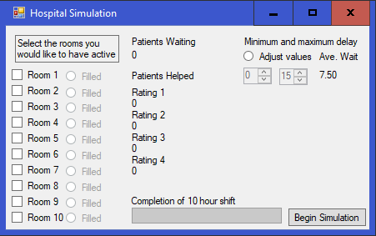
Screenshot

Slide 7
Constraints
Windows
C#
Hospital computer
Personal computer

Slide 8
Constraints
Easy to understand
Simplistic interface
Minimal user input
Intuitive operation

Slide 9
Similar products
SimCAD Process Simulator
Data Structures

Slide 10
Questions

